Slide 1

IP-mine
Machine Learning for
Patent Similarity Match
Ganesh, Lin, Nalini, Nilesh
W210 Fall 2107 Capstone

Slide 2


Problem Definition
How do I determine if my patent claim idea is unique enough to be patentable?
Instead of mining millions of patent from USPTO for matches, is there a tool that can help determine uniqueness of my claim?
Will the tool provide answers within reasonable time?
Will the tool be easy to use?
Will the tool provide with just the right amount of information to enable me move forward?

Slide 3

Target Market for IP-Mine
Patent lawyers
Patent departments within organizations
Inventors searching for similarity of their claims with respect to patent claims that have been approved
USPTO patent application process
USPTO patent review process

Slide 4

Why IP-Mine is the need of the hour?
Thousands of new patents are filed every year and millions are granted already
Sorting through the system to determine uniqueness is time consuming and costly
IP-Mine helps sort through this costly process in an easy way with a simple user interface
It is fast, accurate and simplifies the search process without restricting the user to search by keywords like other patent search solutions
IP-Mine Uses Machine learning to find matches and determine uniqueness

Slide 5
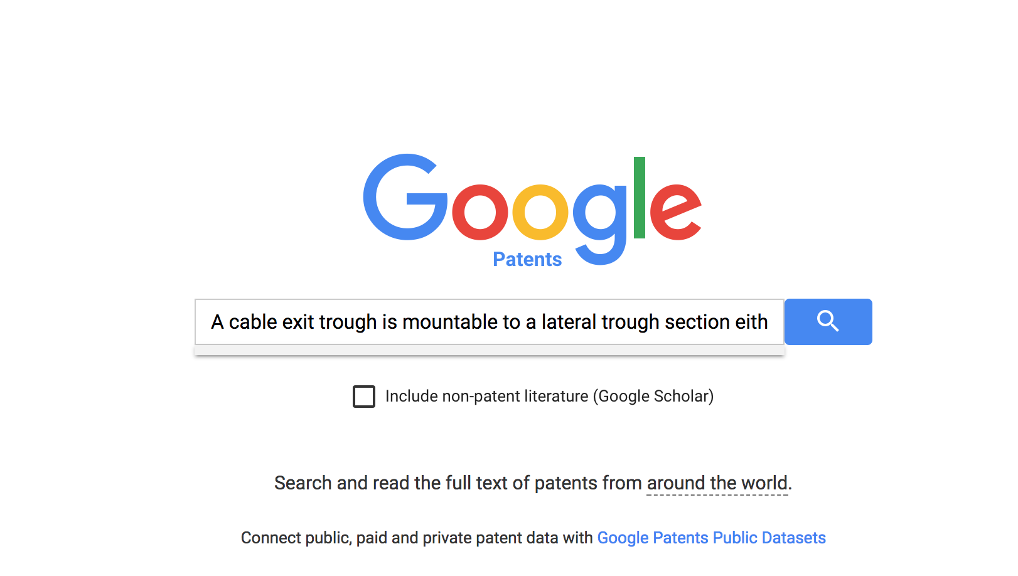
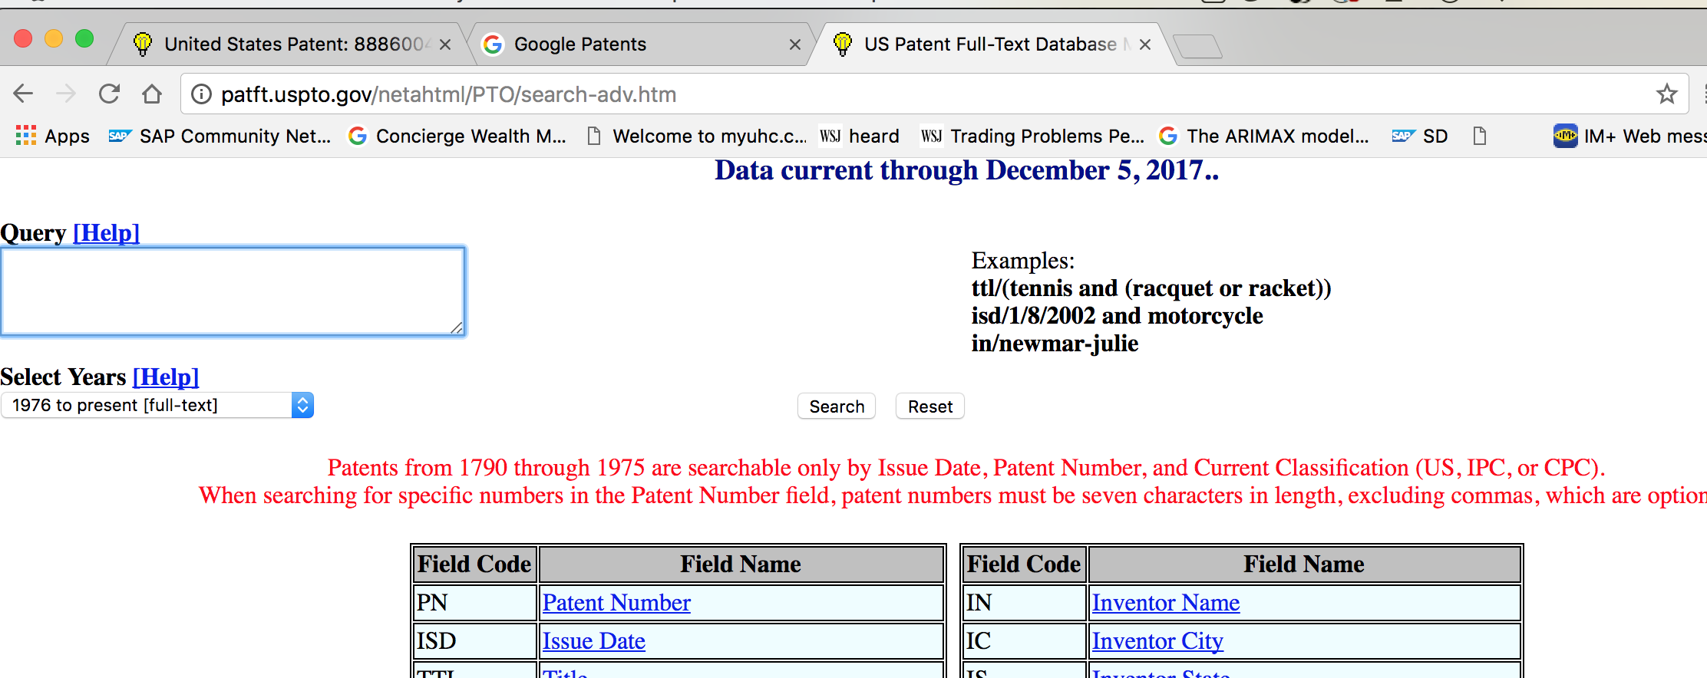
Demo
Most current tools expect the users to enter a specific search string or a word
They also expect the users to know which predefined cluster/class the claim may belong to
Patent attorneys or Inventors need to find and limit the key terms in their claims for search which can result in incorrect/inconsistent prior art search.

Slide 6
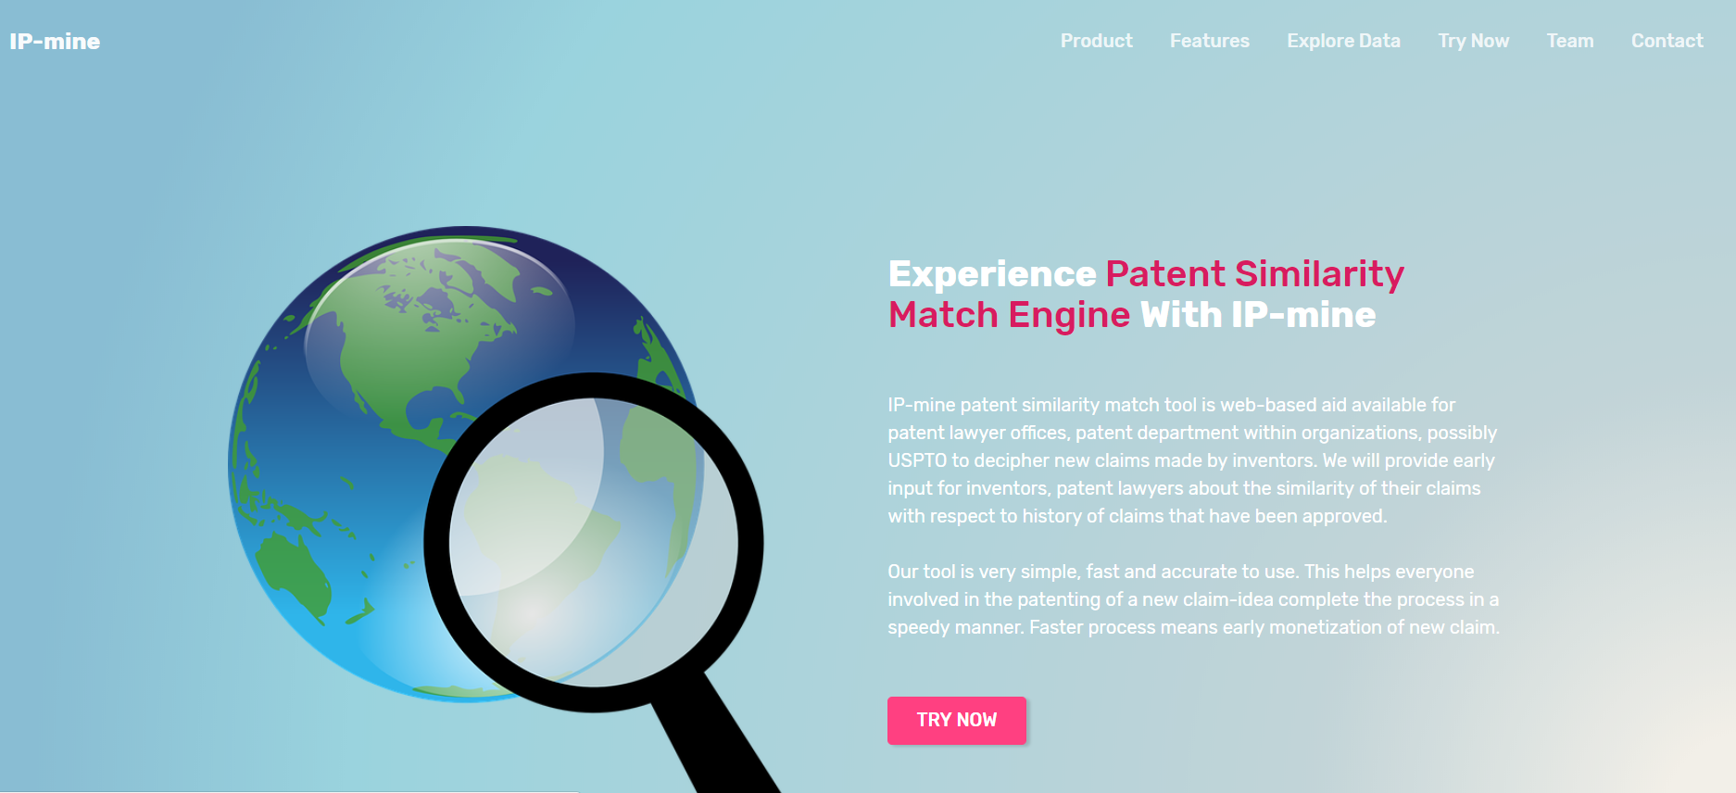
Demo
Application url: http://patentfinder.herokuapp.com/

Slide 7
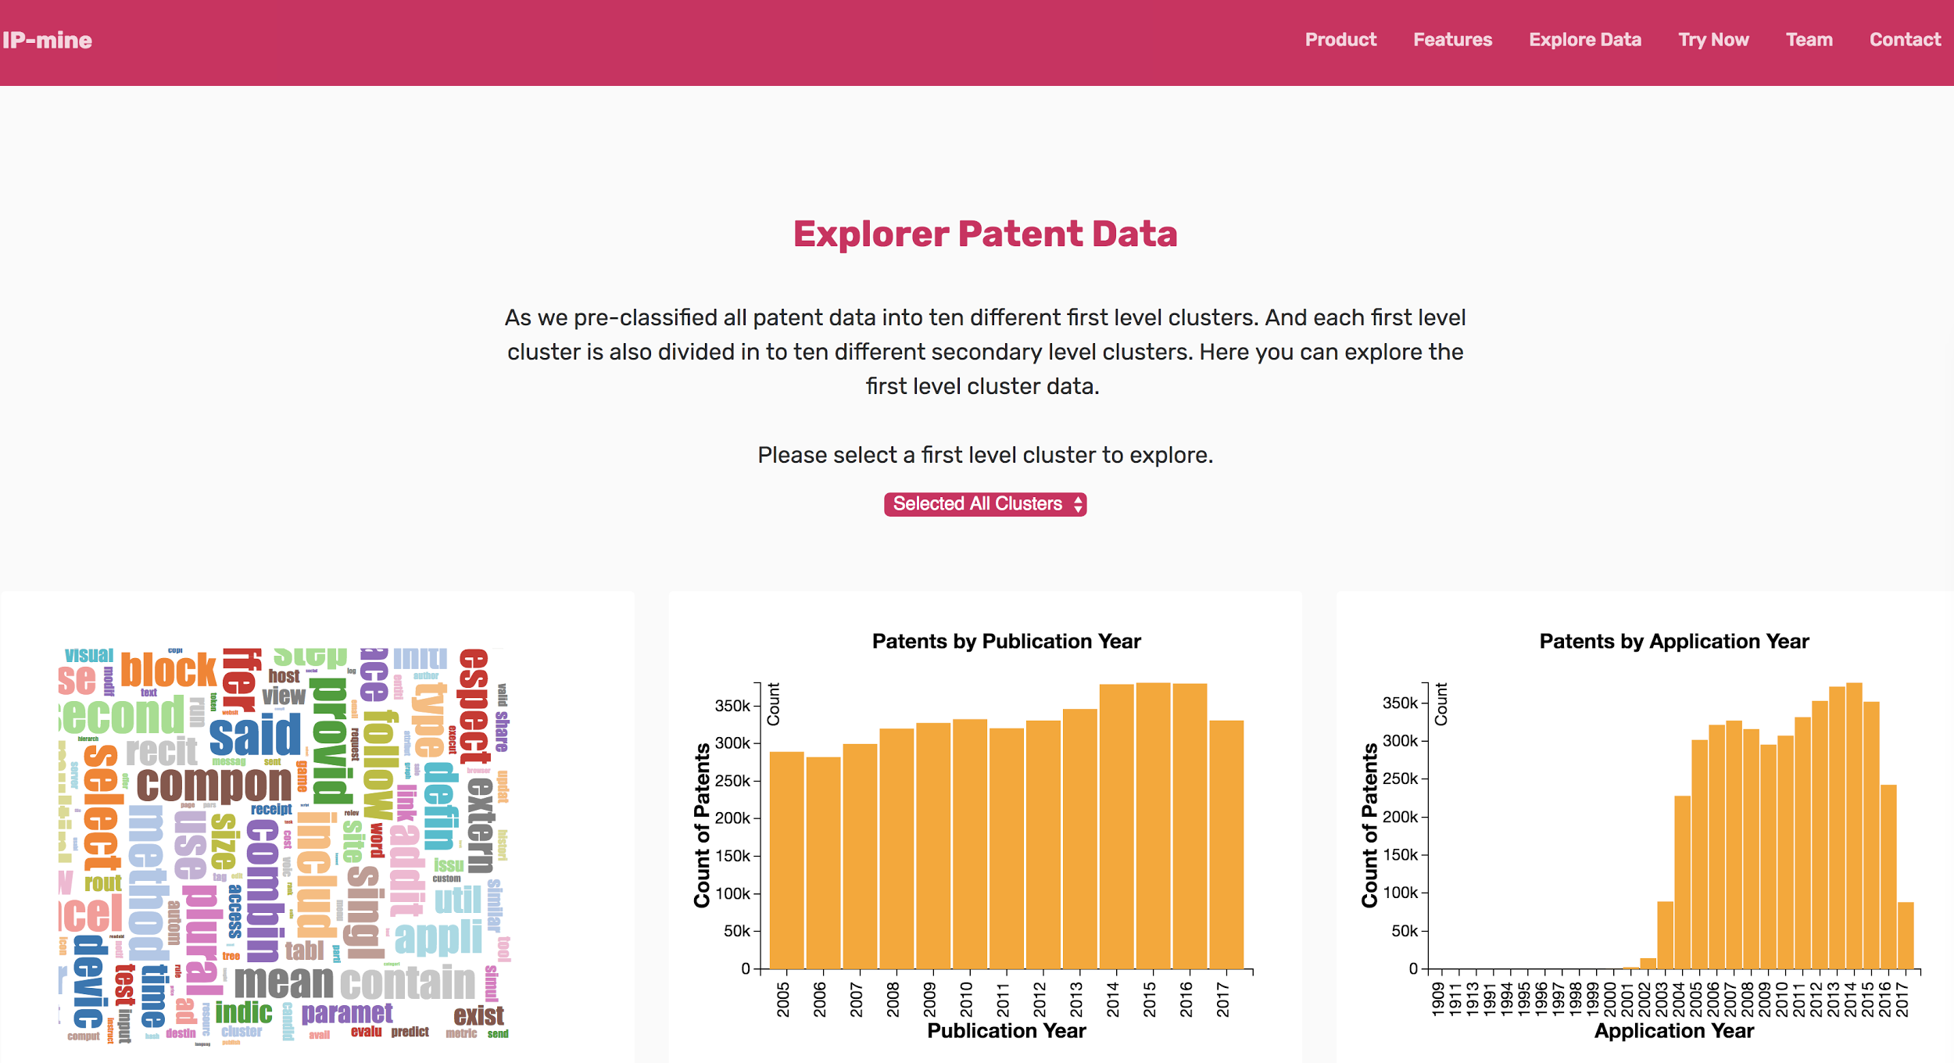
Demo

Slide 8
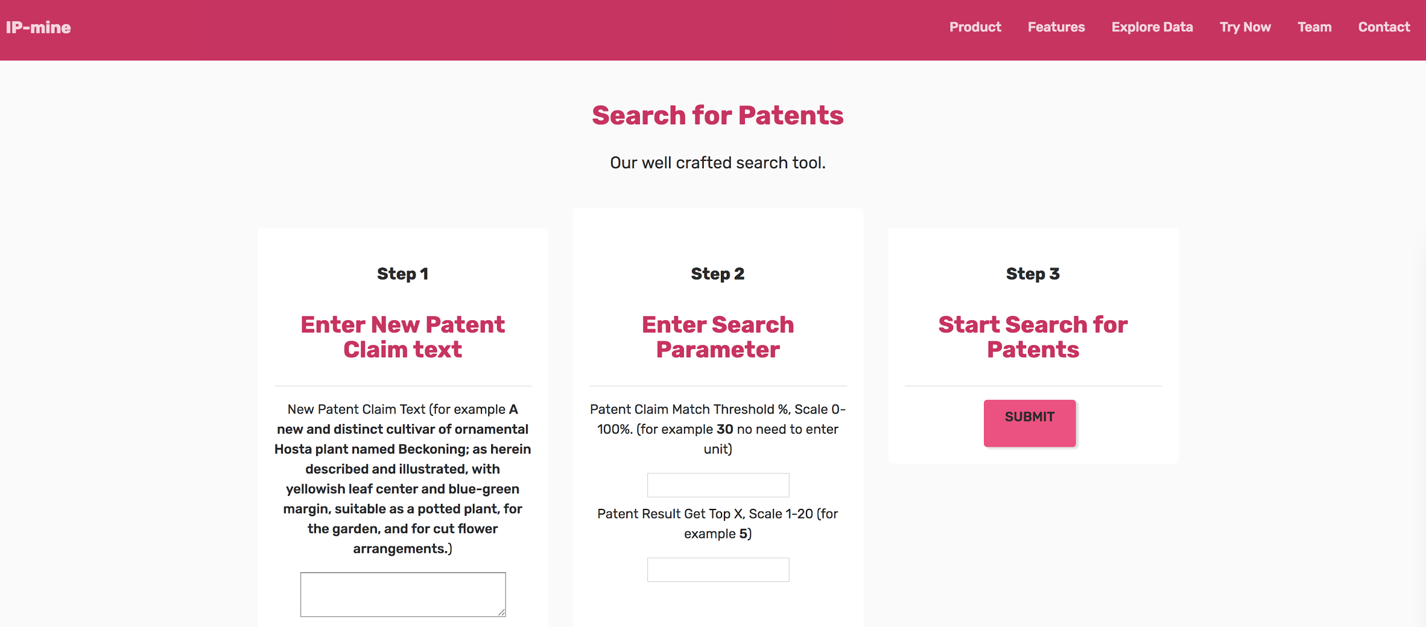
Demo

Slide 9
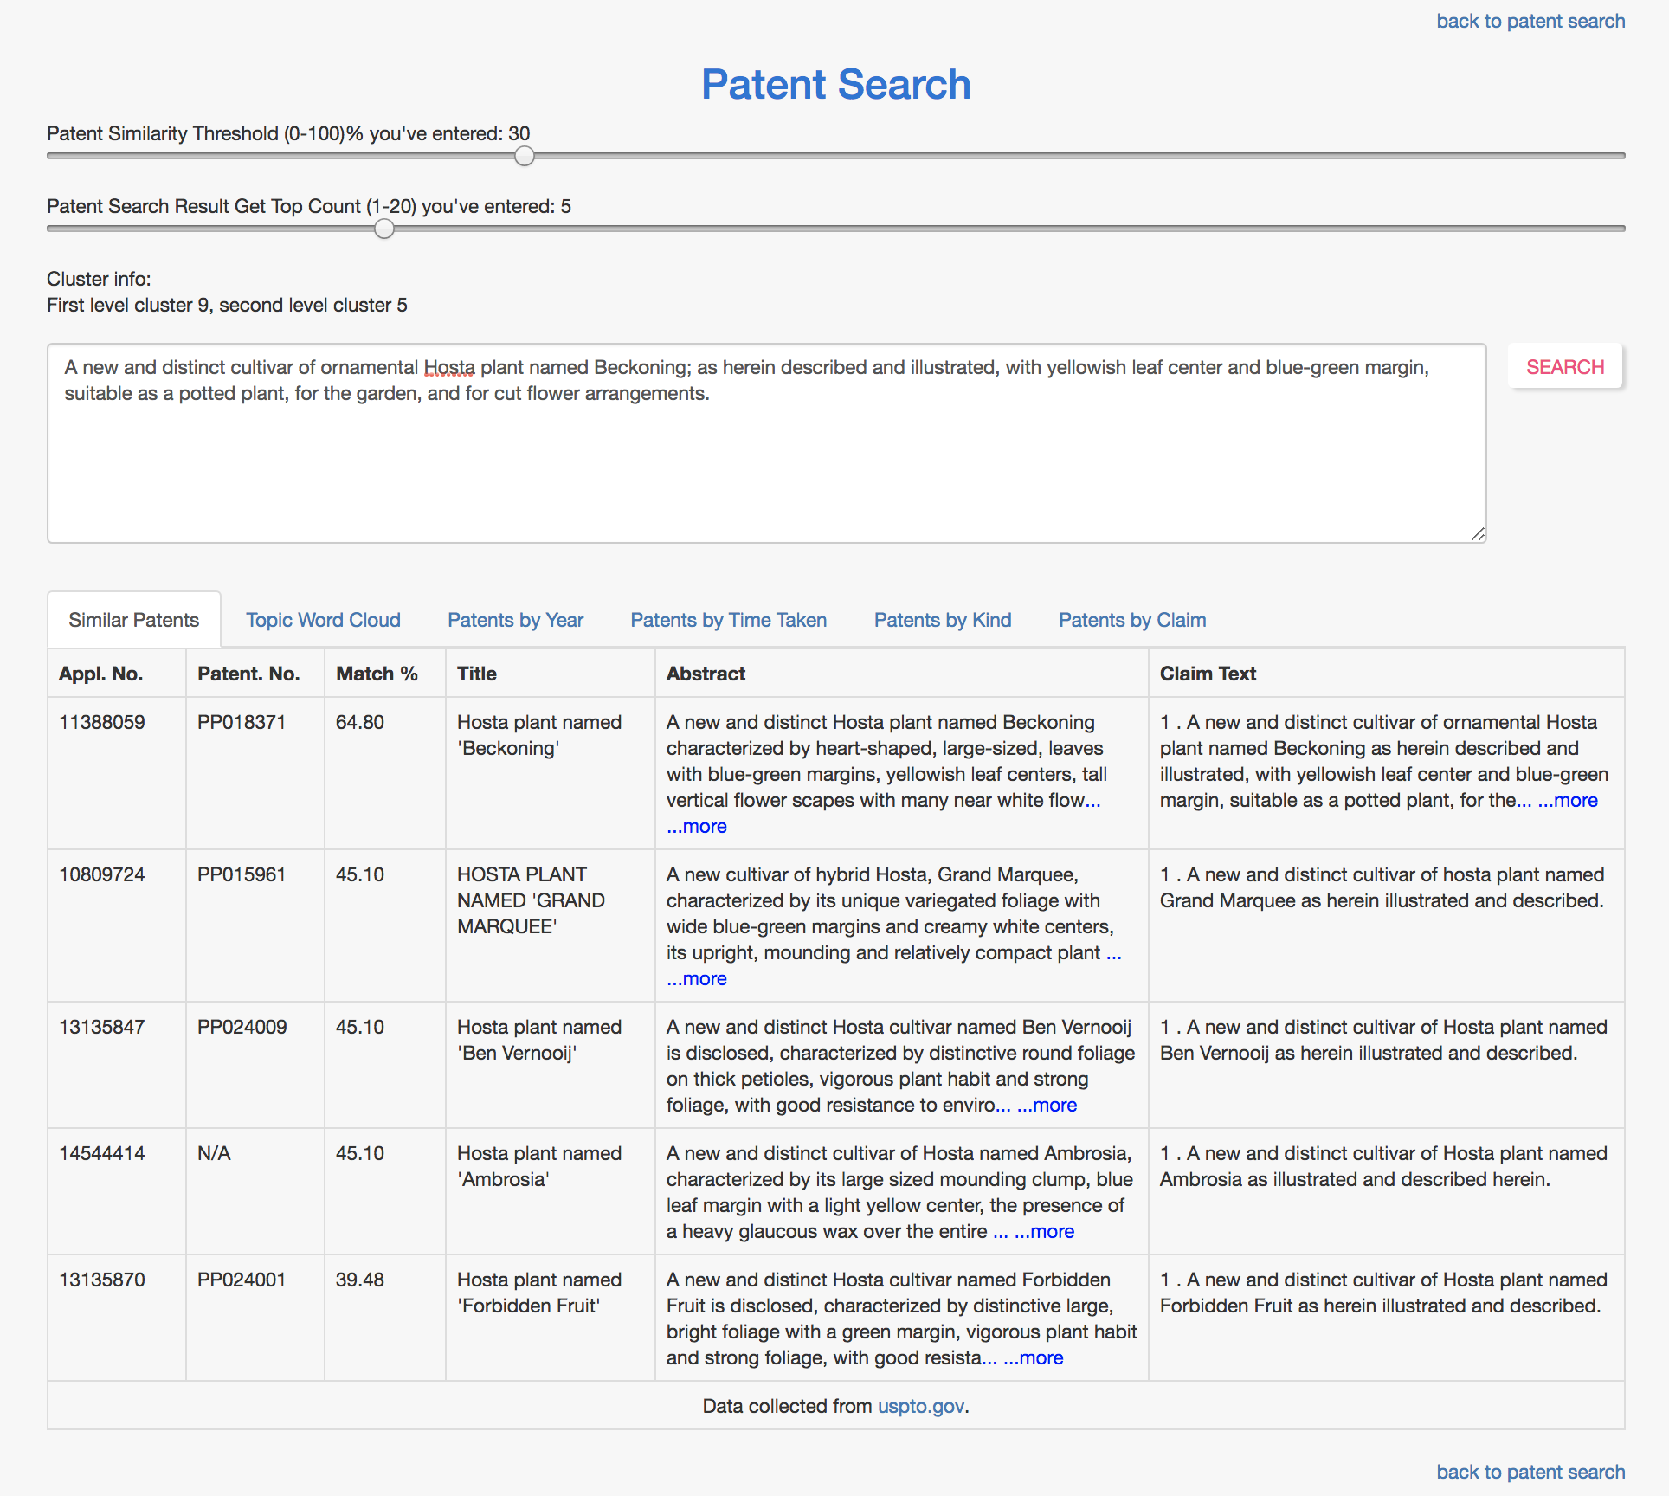
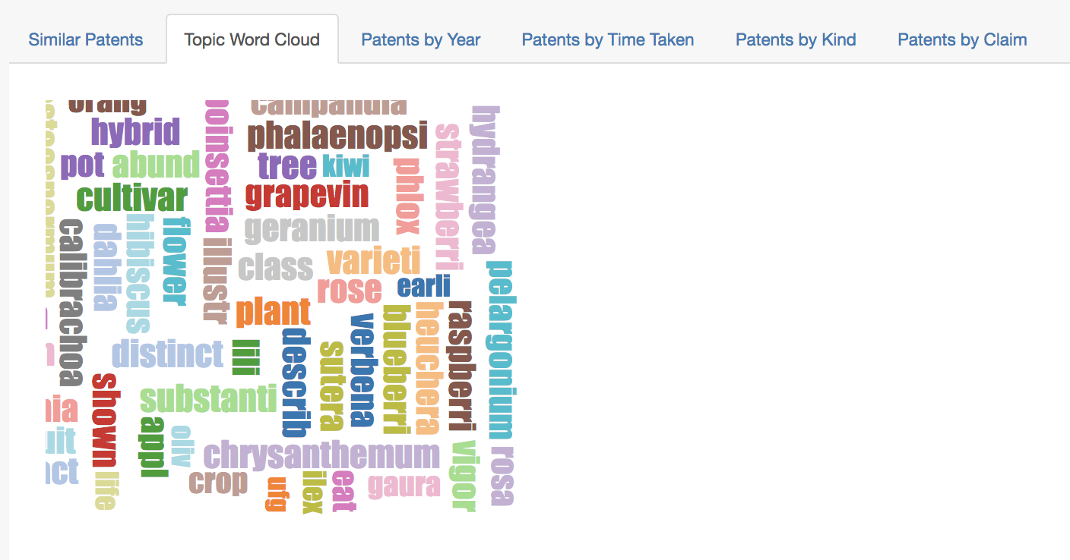
Demo

Slide 10
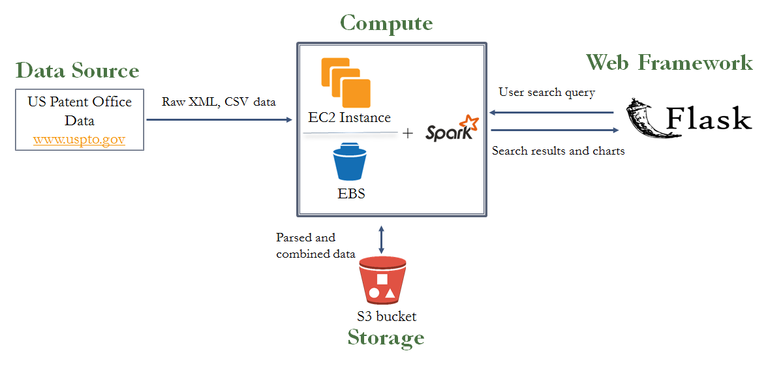
System Architecture

Slide 11
Machine Learning Models
Topic Modeling using Non-negative Matrix Factorization:
Clean, tokenize and stem the claims data
NMF topic modeling to create 10 Top clusters
Fit 4M patent documents to the NMF model to find documents in each top cluster
Create 10 Sub clusters from each top level cluster
Fit all Top cluster documents to find documents in each Sub cluster
TF-IDF Cosine Similarity Calculation:
Create TF-IDF models for each top level cluster patent documents
Exploratory analysis of top level patent documents cluster and save distributions
Create TF-IDF models for each sub-level cluster patent documents
Do exploratory analysis of sub level cluster Patent documents and save distributions
Upload all the model and cluster data files to Storage (AWS S3)

Slide 12
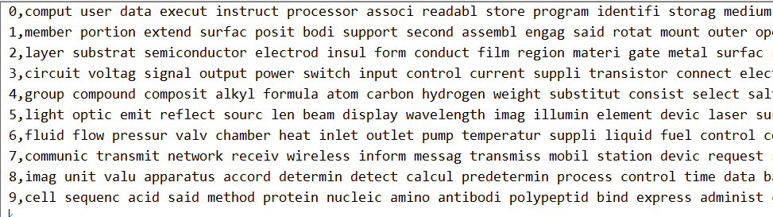
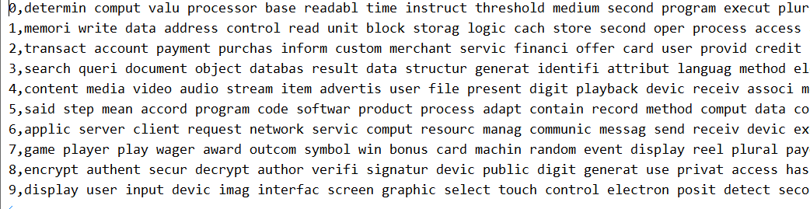
Topics and Clusters
Top Level Clusters Topics
Sub Level Cluster Topics for
First Top cluster

Slide 13

Future of IP-mine
Enhance this patent similarity match solution to add patent keyword match to make it a complete solution
Include a new feature of comparing two claims to provide a similarity score
Set up the data flows for weekly delta to be loaded, refine the UI and package the solution
Plan for a scalable and faster hardware to meet the needs of increasing data sizes and user load
Come up with go-to-market strategy

Slide 14
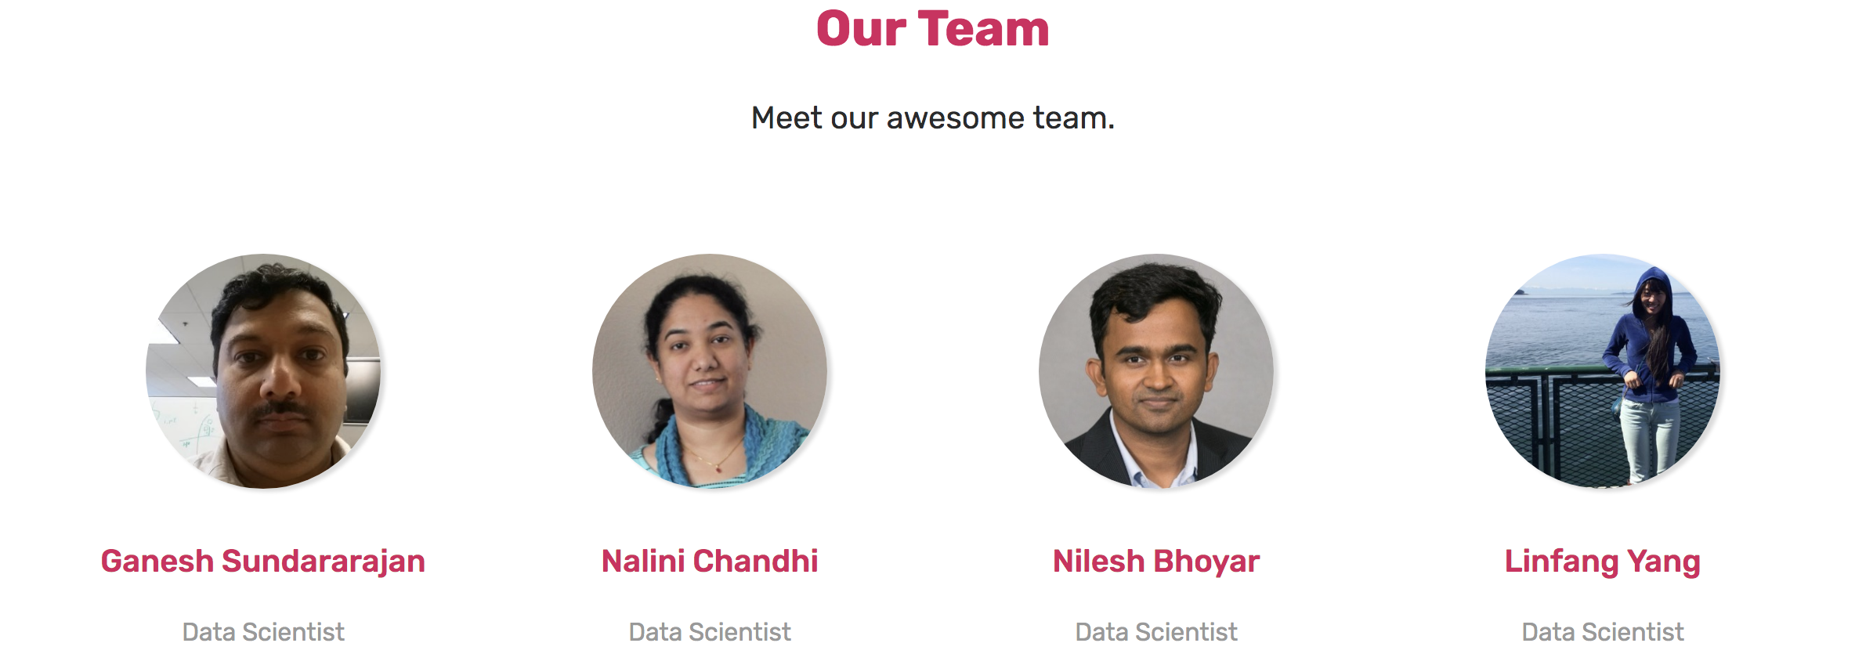
Thank you
IP-Mine Team

